Slide 1
4.1 Rational numbers, opposites, and absolute value

Slide 2
Real Number System
Whole Numbers
All positive numbers including 0
0, 1, 2, 3, 4, 5…
Integers
Whole numbers and their opposites
…, -3, -2, -1, 0, 1, 2, 3, …
RATIONAL NUMBERS:
A rational number is a number that can be written as where b does not = 0.
½ , ¾ , 5/8

Slide 3
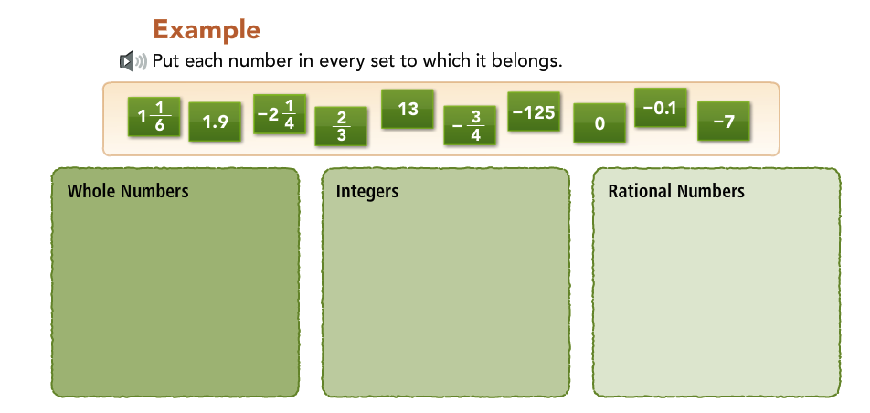
Your turn to categorize!

Slide 4
Think…Pair…share
Read the problem along with me as I read aloud to the class.
Think to yourself SILENTLY about the solution and reasoning to the problem
WHEN I SAY….Turn to your partner for 20 seconds and share your thoughts
I will then get the class back together and we will discuss

Slide 5
Think…Pair…share
One of your friends says that the number 4/4 belongs only in the category Rational Numbers. Another friend says that it belongs in the category of Whole Numbers, Integers, and Rational Numbers.
WHO IS CORRECT?

Slide 6
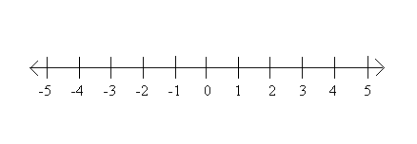
Opposites
Opposites are numbers are the same distance on both the left and right side of zero.

Slide 7
What is the opposite of….
5
-9
-1/2
4/5
6

Slide 8
Absolute Value
Absolute value is the distance a number is away from zero on the number line

Slide 9
What is the VALUE of….
|5|
|-9|
|-1/2|
|4/5|
|-6|

Slide 10
WHERE IT GETS TRICKY…
|5| |-5| -|5| -|-5|

Slide 11
Practice
DIGITS 4.1 Homework
MUST SHOW WORK ON PAPER!!!!
Title the homework “4.1 Digits”

