Slide 1
PH 3.1 – 3.2 Inequalities with addition and subtraction

Slide 2
Less than
Less than or equal to
Equal to
Greater than
Greater than or equal to

Slide 3
Number Line Circles and Shading
Open Circle Closed Circle
Left Right

Slide 4
TEST POINTS
A point chosen by you to determine if it satisfies the inequality.
It helps you to determine if you have shaded correctly and/or where to shade (This is more useful on coordinate plane graphs)

Slide 5
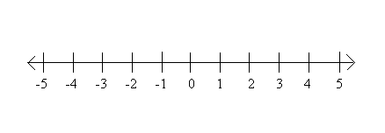
Examples
x > 4
b < -3

Slide 6
How to Solve
Ignore the sign at first.
Solve as though it were an equal sign (Just like a normal equation)
Then, put the inequality sign back in the solution.

Slide 7
Reminders:
When there is a fraction as a coefficient to the variable ( Example: 3/4x), you must multiply both sides of the equation by the RECIPROCAL of that fraction to clear it from the variable.

Slide 12
Extra Notes

Slide 13
PH 3.3 Solving Inequalities with Multiplication and Division

Slide 14
Rule:
When multiplying or dividing by a negative number, you must FLIP THE SIGN

Slide 21
PH 3.4 Solving Multi-Step Inequalities

Slide 22
Remember:
Combine like terms first
GOAL: Get the variable by itself through addition or subtraction
Multiply or divide to isolate the variable
Write the solution with the variable first.

