Slide 1
4.9 Graphing Data on the Coordinate Pane

Slide 2
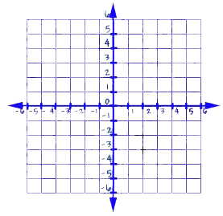
Quadrants

Slide 3
Ordered Pairs
(x, y)
x → “the left right direction”
Y → “the up down direction”

Slide 4
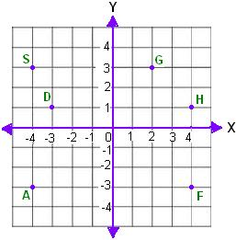
Identify the ordered pairs for each point on the grid.

Slide 5
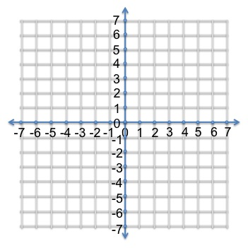
Graphing Points

Slide 6
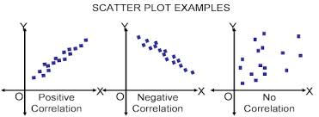
Scatter Plots
A graph that represents two groups of data.

Slide 7
HW
p. 63
#20-34 ALL
#40

