Slide 1
1.2 Exponents and Order of Operations

Slide 2
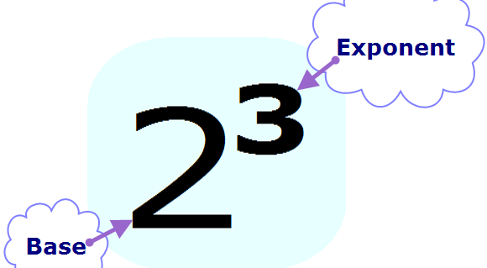
Exponents

Slide 3
Exponents
What is another way to write:
3⁴
6•6•6•6•6•6

Slide 4
Tricky Exponents
3²
(-3)²
-3²
-(3²)

Slide 5
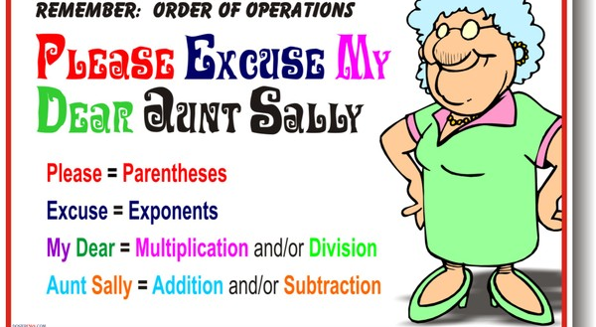
Order of Operations

Slide 6
ALWAYS REMEMBER..
Compute multiplication or division as it appears from LEFT TO RIGHT
Compute addition or subtraction as it appears from LEFT TO RIGHT

Slide 8
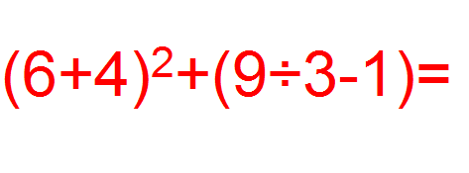

Slide 9
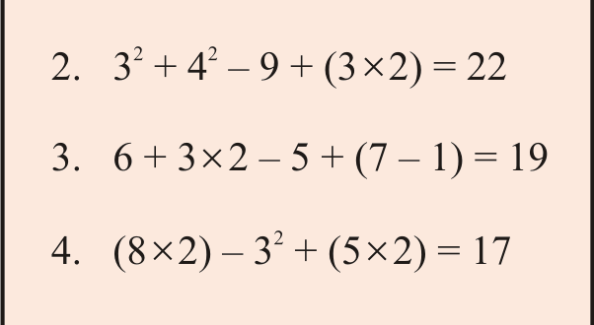
Try these!

