Slide 1
1.1 Expressing Rational Numbers with Decimal Expansions

Slide 2
Rational Number
Number that can be written as a fraction
-1/5 2 9/8 -6/3

Slide 3
Terminating Decimal
A decimal expansion that terminates in all 0’s
A TERMINATOR stops bugs.
A decimal that stops / ends

Slide 4
Terminating Decimals
¼
5
- 4/100

Slide 5
Repeating Decimal
Has a decimal expansion that repeats the same digit, block of digits, and DOES NOT END

Slide 6
Repeating Decimals
1/3
-4/9
49/33

Slide 7
Fraction to Decimal Conversion
Old school division
Numerator (top) goes into the house
Denominator (bottom) goes in front of the house.

Slide 8
3/16 87/24

Slide 9
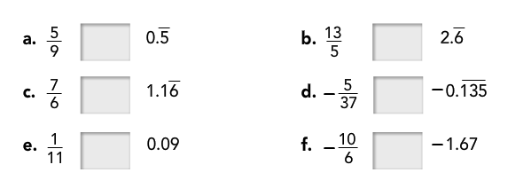
Comparisons Use <, >, or =

Slide 10
Supreme Court
Elena Kagan’s confirmation to the US Supreme Court was historic. For the first time, 3 of the 9 justices on the court were female. What is 3/9 written as a decimal?

Slide 11
United Center
There are two parking lots near the United Center. The covered parking lot is 5/6 miles away. The open-air parking lot is 0.8 miles away. Which parking lot is closer to the United Center? Explain how you know.

Slide 12
Classmate
A classmate says that 0.285714 is not a rational number because it does not terminate. Is she correct? Explain.

